Slide 1


Professional Growth and
Self-Reflection in the
Teacher Professional Growth &
Effectiveness System

Slide 2

Learning Targets
I can. . . .
identify how reflection and growth planning is connected to improved educator effectiveness
understand the process for self-reflection and professional growth planning

Slide 3
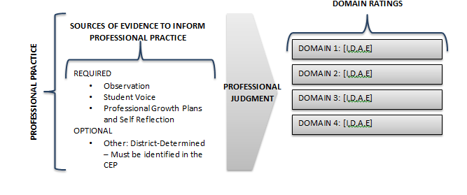
Notes:
This chart in the Model Certified Evaluation Plan created by KDE shows us how evidence of professional practice will result in ratings in each of the Domains of the Framework for Teaching. Notice on the left that there are several sources of evidence for this, including observation, student voice, professional growth plans and self-reflection. Also, notice that districts can also identify other sources of evidence as appropriate.

Slide 4
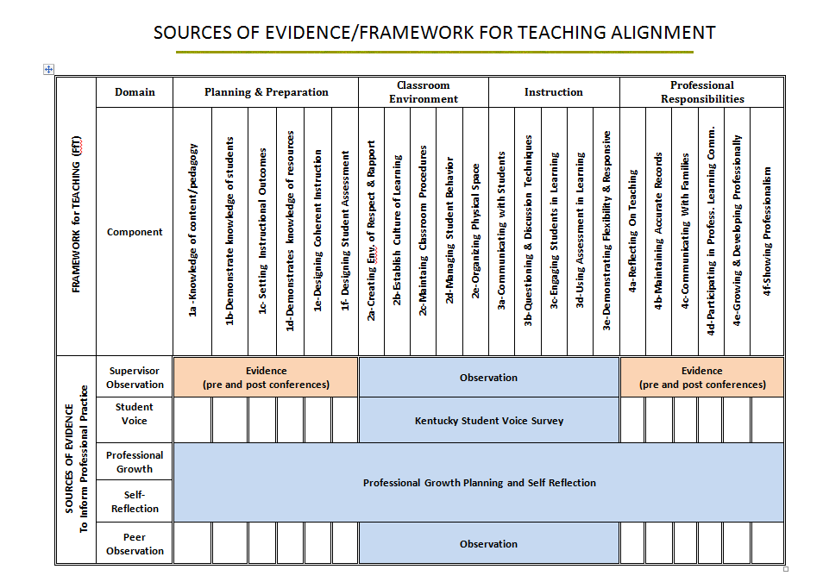
Notes:
This matrix, also included in the Model CEP, shows how required sources of evidence align with the domains in the Framework for Teaching. Notice that it is the pre- and post-observation protocols that can provide evidence related to planning & preparation and professional responsibilities, domains 1 & 4. Additionally, professional growth planning and self-reflection provide evidence in these domains. These domains are not considered “observable” domains in the sense of classroom observations.
As stated earlier, districts may also require additional sources of evidence to support ratings in any of the domains.

Slide 5
Self-Reflection
means the process by which certified personnel assesses the effectiveness and adequacy of their knowledge and performance for the purpose of identifying areas for professional learning and growth

Slide 6
Professional Growth Plan
An individualized plan that is:
focused on improving professional practice and leadership skills
is aligned with educator performance standards and student performance standards
is built using a variety of sources and types of student data that reflect student needs and strengths, educator data, and school/district data
is produced in consultation with the evaluator

Slide 7
“Advocates of professional development for teachers are not arguing that teaching is of poor quality and must be fixed. Their advocacy for professional development for teachers reflects the recognition that teaching is so hard that it is never perfect; no matter how good a lesson is, it could always be improved.” ( Danielson, Talk About Teaching (2009).
Notes:
Advocates of professional development for teachers are not arguing that teaching is of poor quality and must be fixed. Their advocacy for professional development for teachers reflects the recognition that teaching is so hard that it is never perfect; no matter how good a lesson is, it could always be improved. ( Danielson, Talk About Teaching (2009).

Slide 8
Connecting Self-Reflection to
Effective Teaching
Effective teachers may reflect on their work formally or informally; for example they may review a day’s work mentally, keep a journal, meet regularly with a mentor or with colleagues, or assess a videotaped recording of their teaching.
(Good & Brophy, 1997; NBPTS, n.d.).
Notes:
Reflection may be formal or informal as it is integrated into every aspect of a teacher’s professional life.

Slide 9

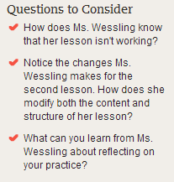
Handout
Notes:
What can you learn from this teacher about reflecting on your practice?
https://www.teachingchannel.org/videos/when-lesson-plans-fail
Vide is 16 minutes

Slide 10
Connecting Self-Reflection to
Effective Teaching
When teachers use data to reflect on what worked, what did not work, and what types of changes they might make to be more successful, the likelihood of knowing how to improve increases dramatically.
(Airason & Gullickson, 2006; Tucker, Stronge, & Gareis, 2002).

Slide 11
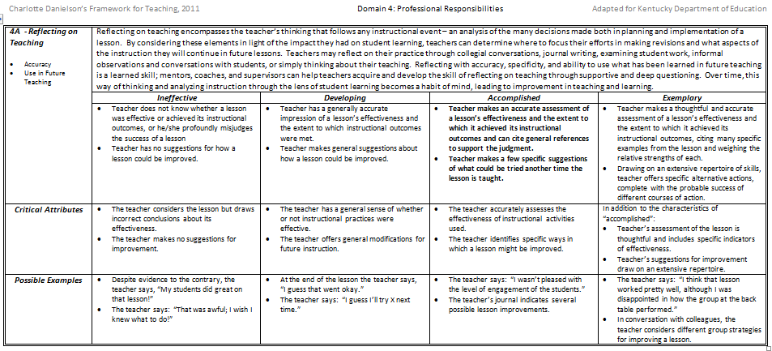
Handout
Notes:
Ask participants to turn in the FfT to domain 4. Point out components 4A and 4E specifically address reflection and professional growth. (Note: Charlotte Danielson uses the term “reflective practice” instead of self-reflection. ). Have participants read through these two components and the performance levels associated with each.
4.A explicitly addresses reflection on a lesson
4.E explicitly addresses growing and developing professionally
This is a screen shot of Component 4A: Reflecting on Teaching from the Framework for Teaching (FfT). Reflecting on teaching encompasses the teacher’s thinking that follows any instructional event-an analysis of the many decisions made both in planning and implementation of a lesson. By considering these three elements (accuracy, use in future, and teaching), in light of the impact they had on student learning, teachers can determine where to focus their efforts in making revisions. Over time, this way of thinking and analyzing instruction through the lens of student learning becomes a habit of mind, leading to improvements in teaching and learning.

Slide 12
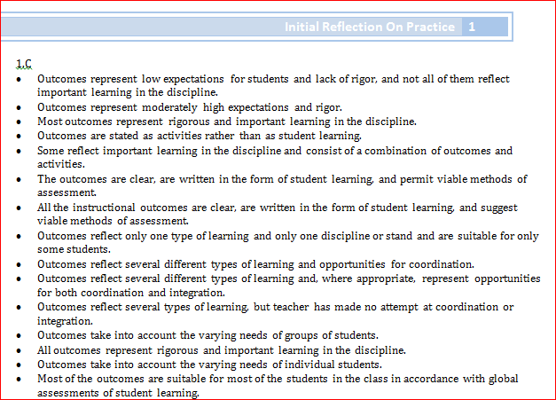
Reflection on Practice Process
Step 1: Highlight or circle the descriptors in each of the four domains that
best describe your teaching practice.
Step 2: Find your highlighted descriptors in the KY Framework for Teaching.
Step 3: Determine your performance level in each of the components.
Step 4: Enter this data into EDS
Handout
Notes:
Using the Initial Reflection on Practice document, an educator reflects on their teaching choosing the descriptors that best describe their teaching practices.

Slide 13
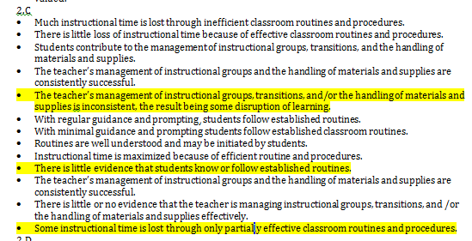

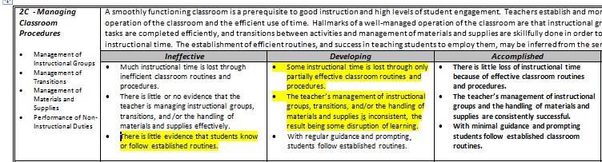
Initial Reflection on Practice
Notes:
After a teacher has chosen the descriptors that best describe their teaching practice, they then refer to the KY Framework for Teaching and find the descriptors within the performance levels. Using this process, a teacher determines their performance level in each of the components in the framework. It is this data that will entered into EDS.

Slide 14
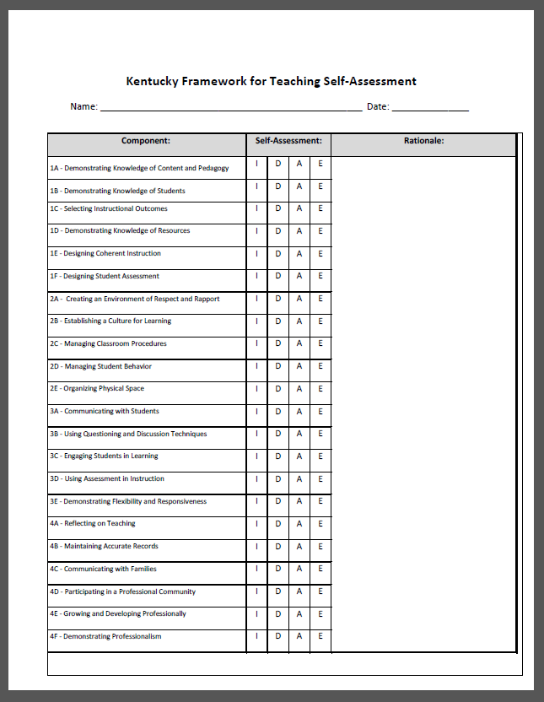
Handout

Slide 15
Places for Self-Reflection
Content standards and skills
Student Voice results
Professional Learning experiences
Recent developments in pedagogical research
An unfamiliar instructional approach
Demographic changes
Student Work
Student engagement during a recent lesson
Notes:
As content standards are evolving to align with CCSS, teachers may want to self-assess their knowledge of content and content-specific skills. Additionally, instructional strategies that support CCSS such as LDC and MDC are new to many teachers; however, self-reflection of practice might focus on instructional approaches.

Slide 16
What does your district CEP say?
When are reflections entered?
  How many?
  Deadlines?
How do they inform the Professional Growth Goal?

Slide 17

A system that focuses on
Professional Growth
Notes:
“Just as in other professions, every teacher has the responsibility to be involved in a career-long quest to improve practice.”
http://www.ascd.org/publications/educational-leadership/dec10/vol68/num04/Evaluations-That-Help-Teachers-Learn.aspx

Slide 18
Considerations for PG planning
Reflection on Kentucky Adapted Framework for Teaching (FfT)
Student growth goal
Content standards and content-specific skills
Student Voice results
Reflection on instructional practice and student outcomes
Other sources identified in the district CEP
Notes:
Just to clarify the process here, before a teacher writes their professional growth goal, a teacher would certainly reflect on their teaching performance using the Kentucky Framework for Teaching. However, teachers can consider other information as well as they make decisions about their professional growth. As content standards are evolving to align with CCSS, teachers may want to self-assess their knowledge of content and content-specific skills. Additionally, instructional strategies that support CCSS such as LDC and MDC are new to many teachers and they may see need to learn new instructional strategies. After a teacher decides a student growth goal and considers the strategies necessary to support students in attaining that goal, it is likely that the teacher would align his or her professional growth planning and goal with the student growth goal if that is an area of need.
All or any of these can be considered as a teacher decides his or her professional growth goal.

Slide 19
Goal setting for Professional Growth
Answer the following to develop a PG goal:
What do I want to change about my practice that will effectively impact student learning?
How can I develop a plan of action to address my professional learning?
How will I know if I accomplished my objective?
Notes:
After reflection, teachers consider these 3 questions to write their professional growth goal. Note this goal is truly about the teacher deciding an area of need for professional learning and growth.

Slide 20

Reviewing a Professional Growth Goal

Slide 21
Sample Professional Growth Goal
Any content area – formative assessment
During this school year, I want to embed formative assessment practices in my daily instruction. I will study Classroom Assessment for Student Learning, by Rick Stiggins, with my PLC team and begin to implement Keys to Quality Assessments. Indicators of success will include: lesson/unit plans with CASL elements (formative assessment cycle, learning targets, students monitoring their own learning); observational data; reflections after implementation; student data review and future instruction plans devised during PLC meetings.
Handout
Notes:
Notice how the goal addresses all three questions even if briefly. A teacher will decide the learning that will help him or her attain the goal.

Slide 22
Sample Professional Growth Goal
Any content area – questioning & discussion techniques
During the school year, I will improve my questioning and discussion techniques. I will incorporate the Q-Chart for daily classroom discussions so that students can take ownership of classroom conversations. I will read and implement strategies from Classroom Discussions. Growth will be evidenced through lesson/unit plans that include strategies from the text, observational data, self-reflection after implementation, and student reflections after Socratic Seminars.
Handout
Notes:
Notice how the goal addresses all three questions even if briefly. A teacher will decide the learning that will help him or her attain the goal.

Slide 23
Professional Growth Process
Teacher shares goal with principal via CIITS
Teacher drafts goal
Principal approves goal or asks for revision
Teacher reflects on progress; principal and teacher discuss progress
On going
Teacher implements learning strategies for attaining PG goal

Slide 24
Implement PGP and Action Plan
Are you consistently implementing the Action Plan as agreed in collaboration with your principal?
Notes:
Our past experiences with Professional Growth Planning has taught us that the Action Plan must be consistently implemented as agreed upon during the collaboration between principal and teacher. Teacher reflects on each phase of implementation making adjustments and revisions as needed.
24

Slide 25
Regularly Reflect on
PGP Progress
Are you consistently using multiple data sources to reflect on your professional growth goal(s) status?
Notes:
As the teacher reviews, analyzes and reflects upon student work samples, test data and naturally occurring data generated in teaching and learning, she/he monitors his/her progress towards goal(s) and determining their goal status.

Slide 26
Writing a Professional Growth Goal

Slide 27
What does your district CEP say?
What sources of evidence inform the PGP?
What forms will you use for the PGP?
How will you document progress throughout the year as you work towards your goal?
How many goals will you write each year?

Slide 28
Goal setting for Professional Growth
Answer the following to develop a PG goal:
What do I want to change about my practice that will effectively impact student learning?
How can I develop a plan of action to address my professional learning?
How will I know if I accomplished my objective?
**You should be able to articulate what sources of evidence are informing your decisions when writing your goal.**
Notes:
After reflection, teachers consider these 3 questions to write their professional growth goal. Note this goal is truly about the teacher deciding an area of need for professional learning and growth.

Slide 29
Does it …
Articulate what I want to change about my practice that will effectively impact student learning?
Include a plan of action to address my professional learning?
Include sources of evidence that would serve as success criteria for meeting my objective?

